Slide 1
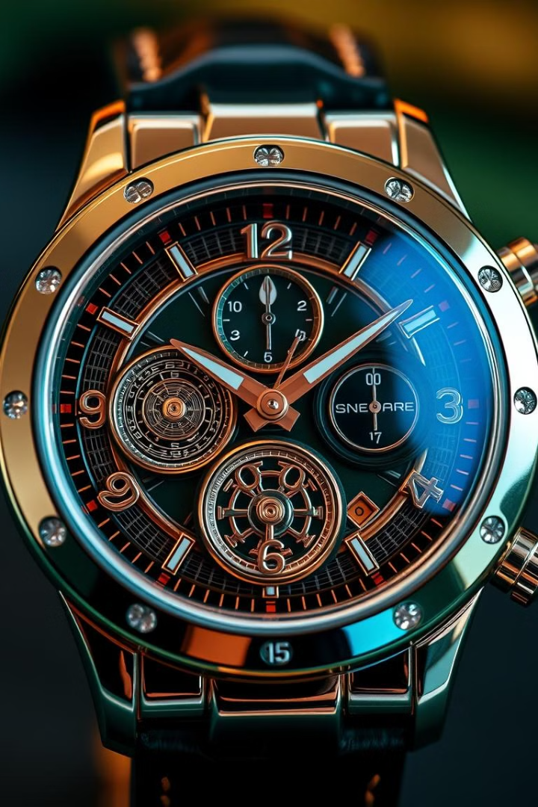


Timeless Elegance: Discover Our Premium Watch Collection
Discover a world of exquisite timepieces, crafted with meticulous attention to detail and timeless elegance. Our collection is designed to elevate your style and make a statement.
Name: Om prajapati
Roll no: 231
Enrollment: 23002171510029
i
Notes:
1

Slide 2
Functionality
1
HTML (Design the webpage layout )
2
CSS (styling the html elements)
3
Bootstrap 5 Components (for responsive design)
Navigation & Internal Linking (Navigate within website)
4
Notes:
2

Slide 3
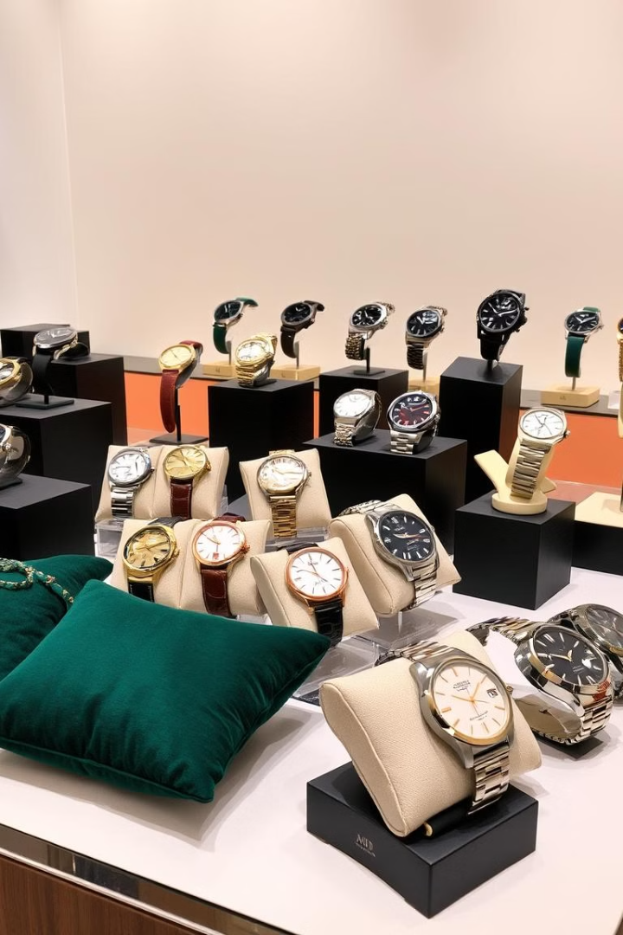
Our Collections: From Classic to Contemporary Timepieces
Classic timepieces with timeless appeal
Contemporary designs that embrace modern trends
1
2
Sport watches for active lifestyles
3
Notes:
3

Slide 4





Exclusive Limited Editions and Signature Series
Rare and collectible timepieces
Limited quantities, often featuring precious metals and gems
A testament to craftsmanship and innovation
Notes:
5

Slide 5

Merits
Attractive UI & User-Friendly Navigation
1
Efficient Product Display
2
Increased Sales & Brand Awareness
3
Notes:
6

Slide 6
Demerits
1
No backend support
2
Limited functionality
3
Not fully responsive
Notes:
6

Slide 7

Thank you
Notes:
7

